Slide 1
Online Voting System
T. Y. BCS PROJECT

Slide 2
INTRODUCTION
1. “ONLINE VOTING SYSTEM” is an online voting technique. In this system people who have citizenship of India and whose age is above 18 years of age and any sex can give his\her vote online without going to any physical polling station. There is a database which is maintained in which all the names of voters with complete information is stored.
2. In “ONLINE VOTING SYSTEM” a voter can use his\her voting right online without any difficulty. He\She has to be registered first for him/her to vote. Registration is mainly done by the system administrator for security reasons. The system Administrator registers the voters on a special site of the system visited by him only by simply filling a registration form to register voter. Citizens seeking registration are expected to contact the system administrator to submit their details. After the validity of them being citizens of India has been confirmed by the system administrator by comparing their details submitted with those in existing databases such as those as the Registrar of Persons, the citizen is then registered as a voter.
3. After registration, the voter is assigned a secret Voter ID with which he/she can use to log into the system and enjoy services provided by the system such as voting. If invalid/wrong details are submitted, then the citizen is not registered to vote.
4. This software project has been developed using the powerful coding tools of HTML, CSS and PHP at Front End and My sql at Back End

Slide 3
SCOPE OF STUDY
1. It is focused on studying the existing system of voting in India and to make sure that the peoples vote is counts, for fairness in the elective positions. This is also will produce:
2. Less effort and less labor intensive, as the primary cost and focus primary on creating, managing, and running a secure web voting portal.
3.Increasing number of voters as individuals will find it easier and more convenient to vote, especially those abroad.

Slide 4
Objectives Of The PROJECT
The specific objectives of the project include:
1. Reviewing the existing/current voting process or approach in India;
2. Coming up with an automated voting system in India;
3. Implementing a an automated/online voting system;
4. Validating the system to ensure that only legible voters are allowed to vote.

Slide 5
The main purposes of Online Voting System include:
1. Require less number of staff during the election.
2. This system is a lot easier to independently moderate the elections and subsequently reinforce its transparency and fairness.
3. Less capital, less effort, and less labor intensive, as the primary cost and effort will focus primarily on creating, managing, and running a secure online portal.
4. Increased number of voters as individual will find it easier and more convenient to vote, especially those abroad.

Slide 6
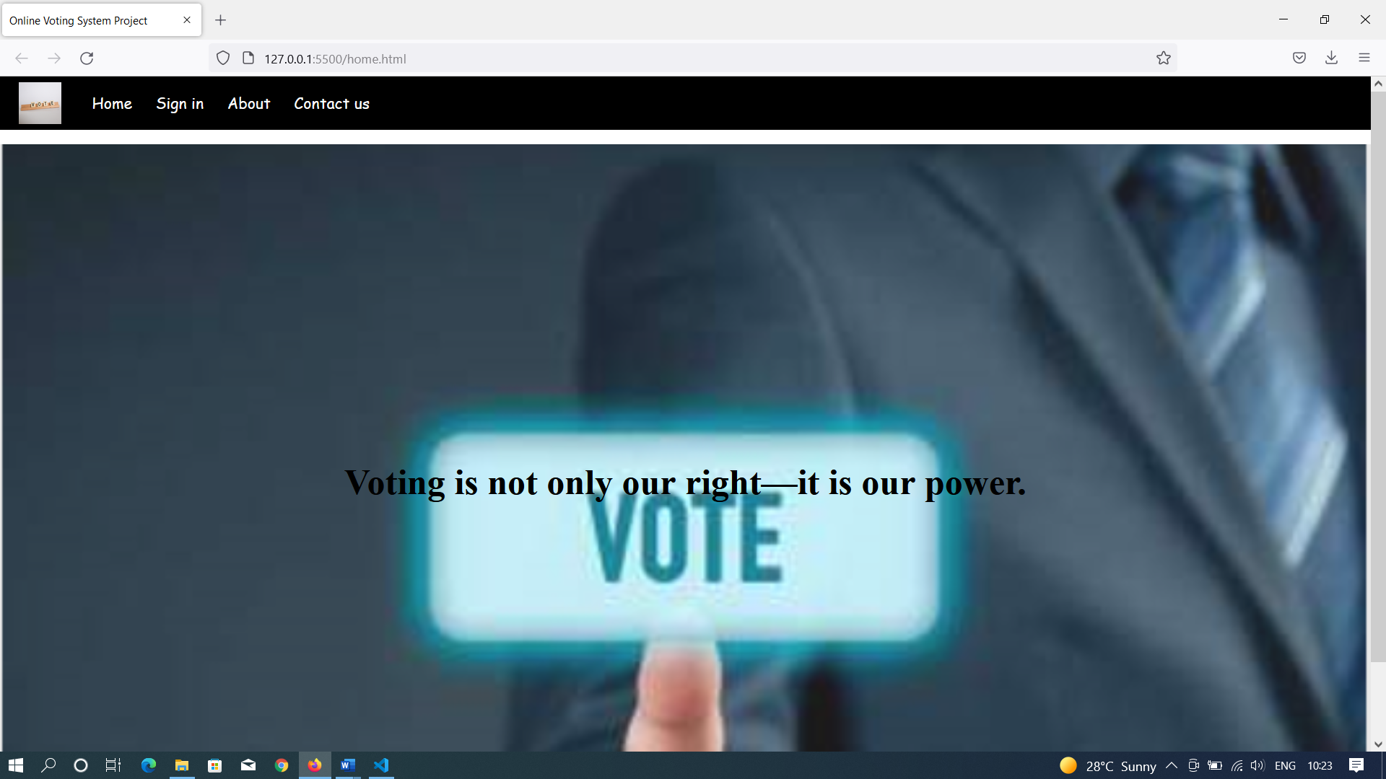
HOME SCREEN

Slide 7
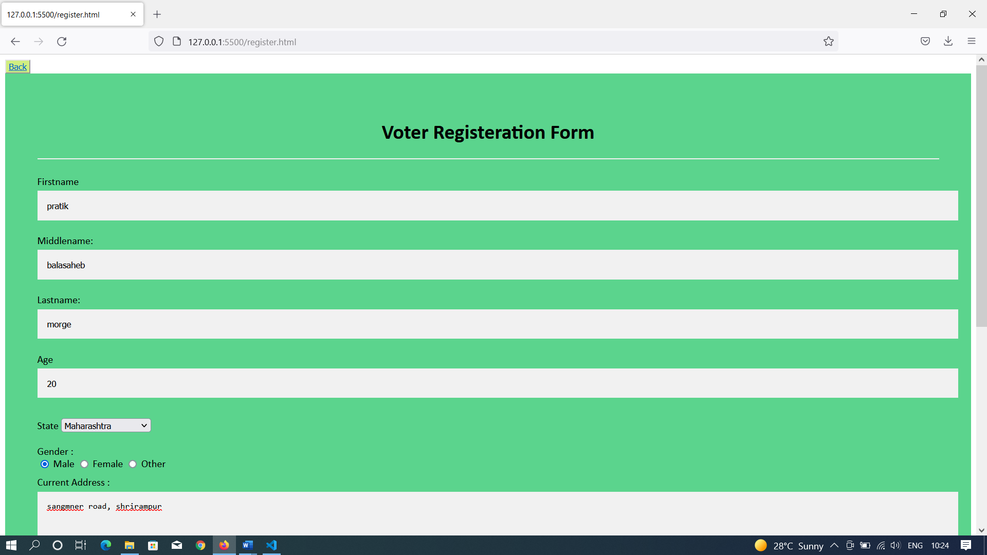
REGISTRATION SCREEN

Slide 8
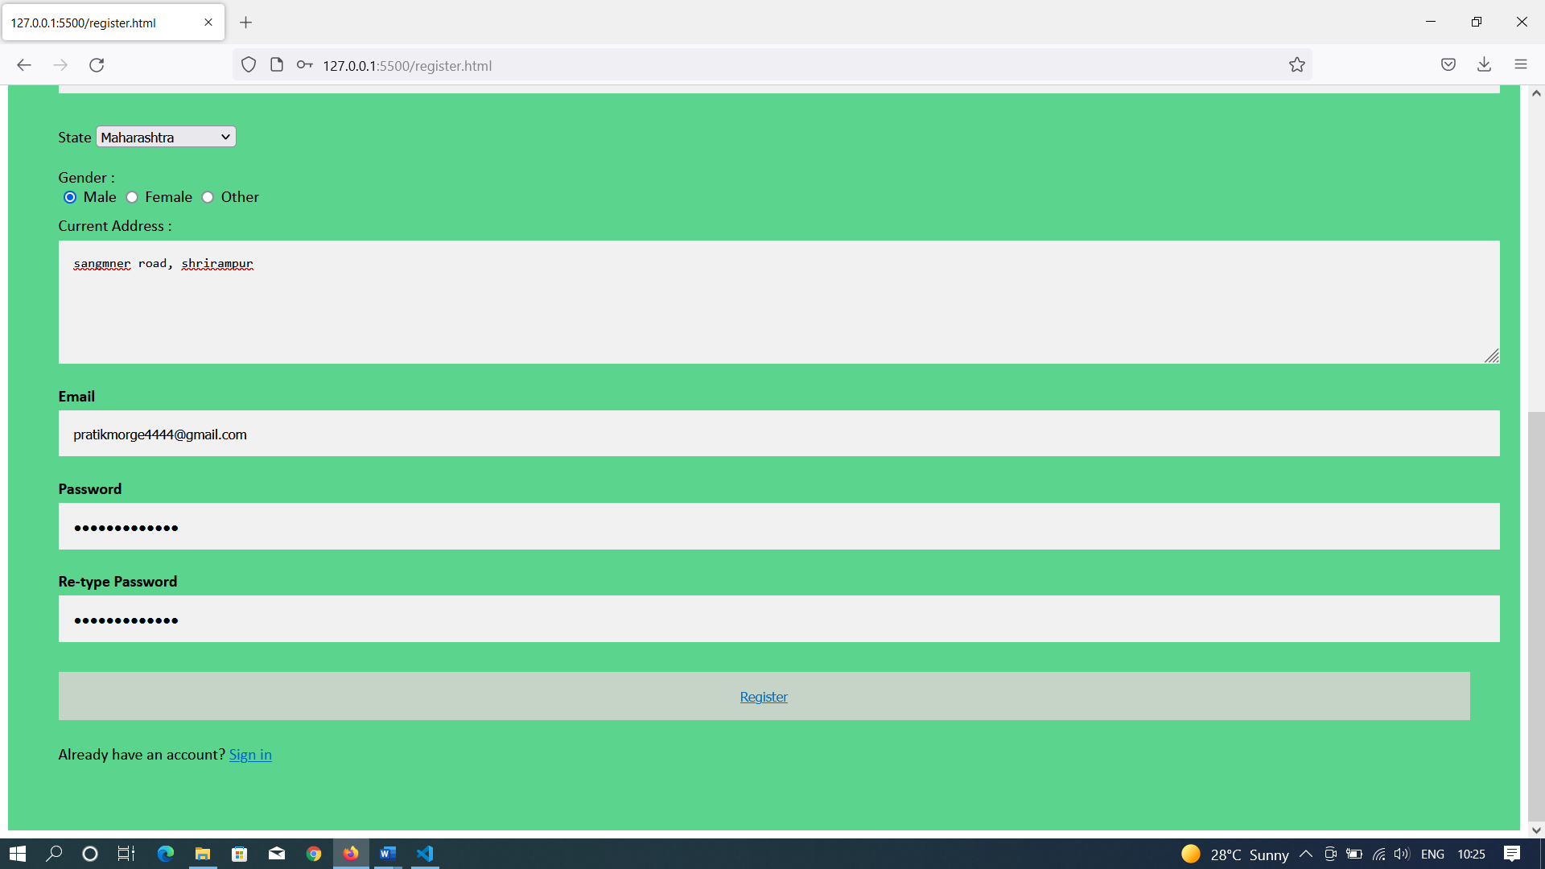

Slide 9
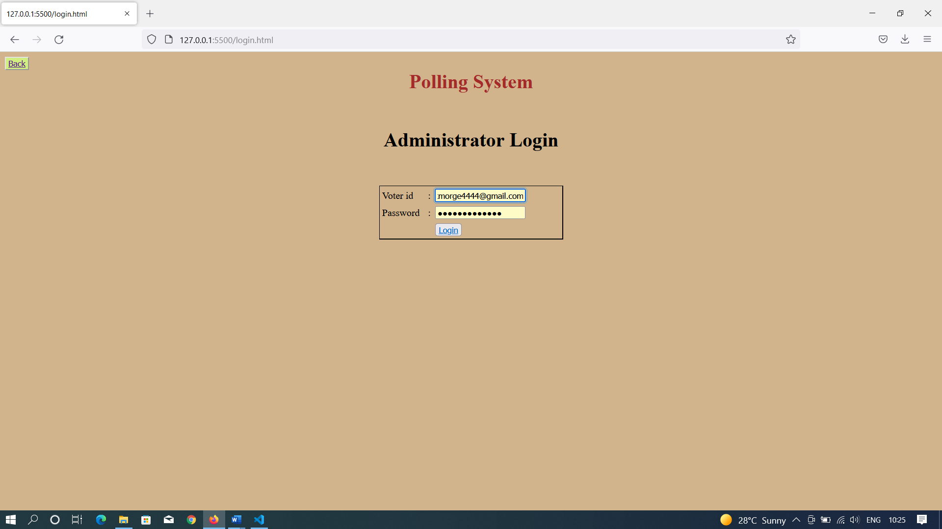
LOGIN SCREEN

Slide 10
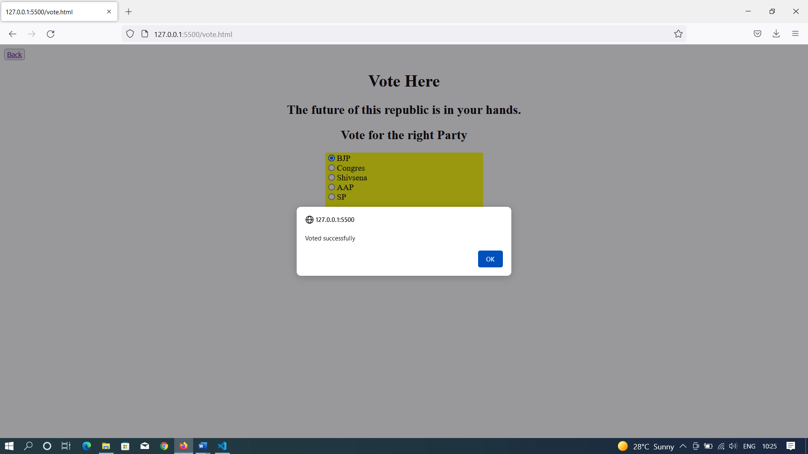
VOTE SCREEN

Slide 11
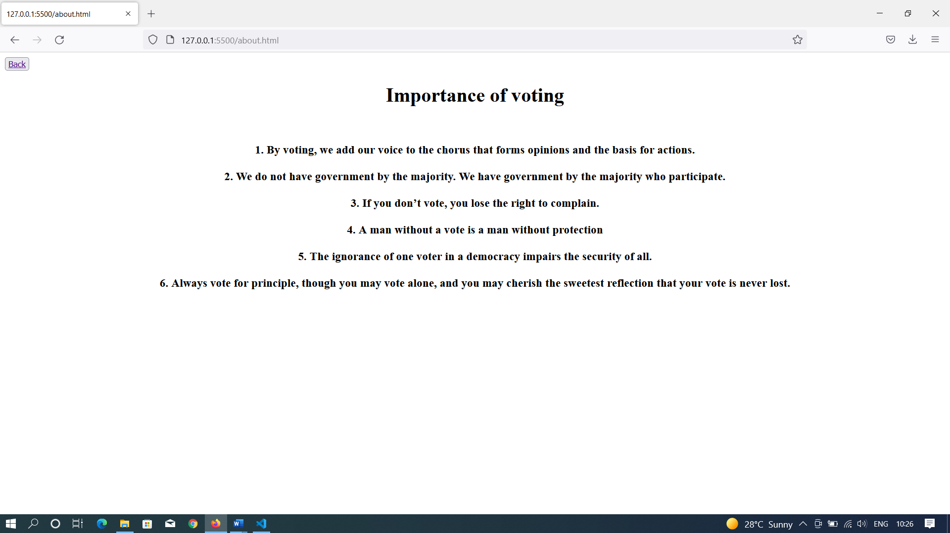
ABOUT SCREEN

Slide 12
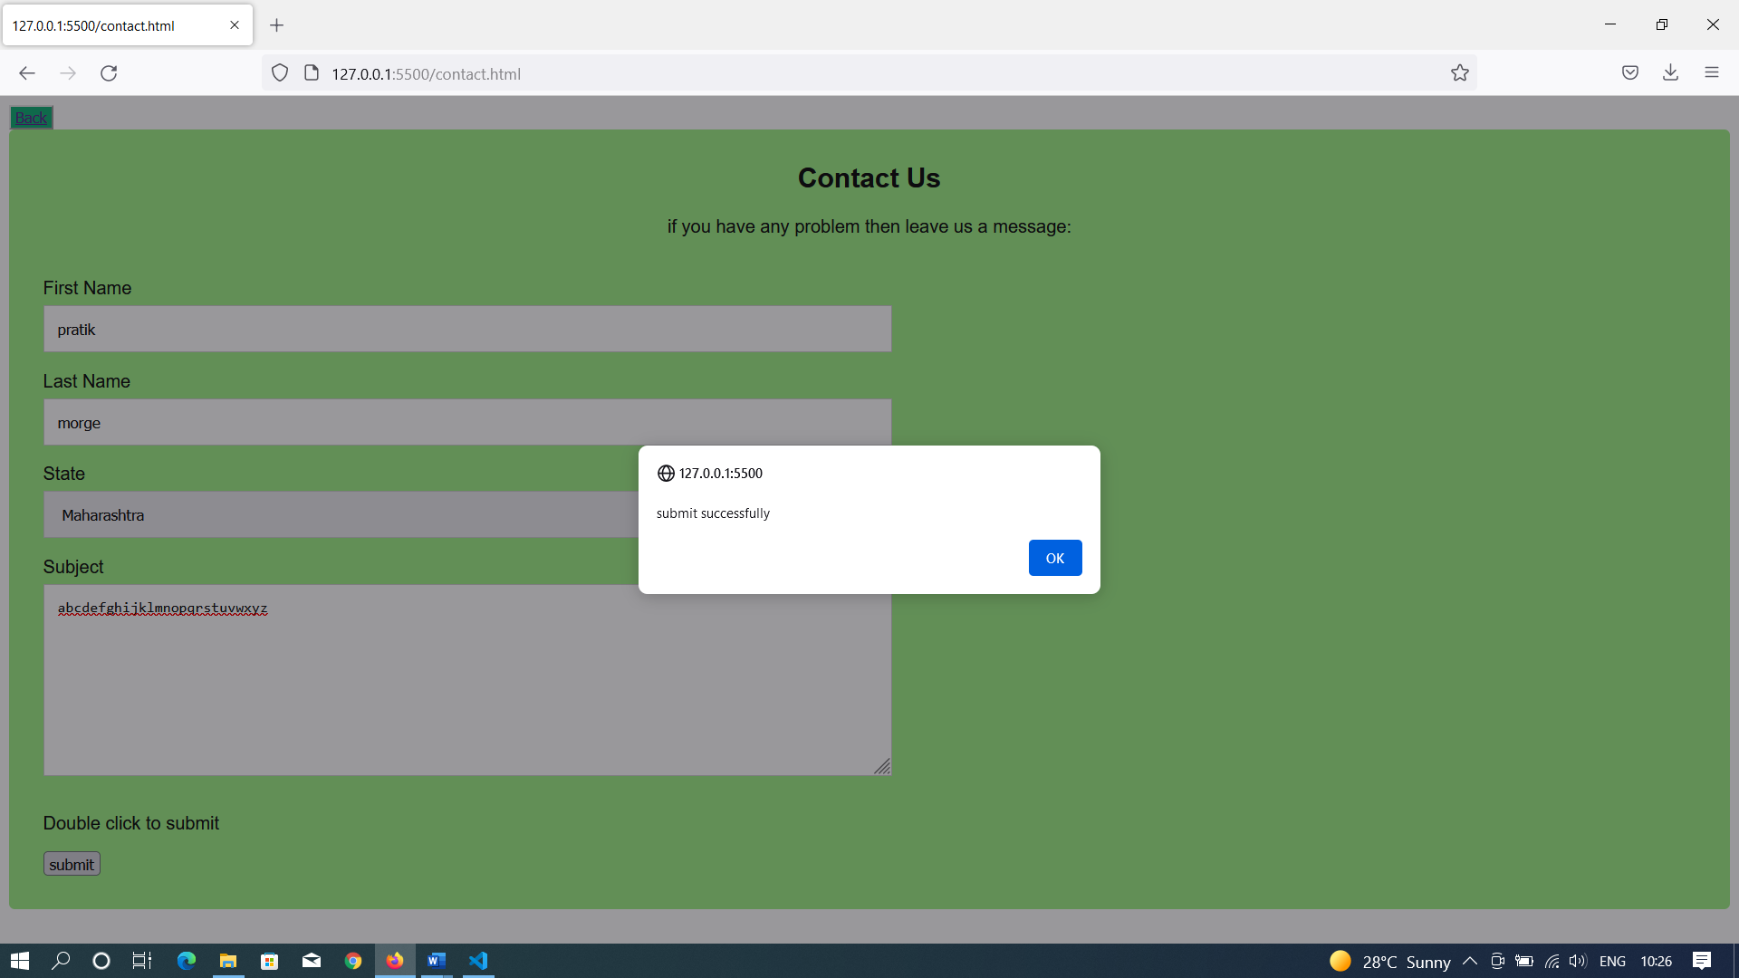
CONTACT SCREEN

Slide 13
Future enhancement
1. The challenge of developing electronic voting systems is not only security but also protecting the secrecy of the ballot, a bedrock principle of free and fair elections. Currently there is “no known technology that can guarantee the secrecy, security, and verifiability of a marked ballot transmitted over the Internet.
2. Blockchain-based voting, which relies on a decentralized, distributed digital ledger is vulnerable to many of the security flaws inherent in internet voting
3. Online and blockchain-based voting would greatly increase the risk of undetectable, nation-scale election failures.

Slide 14
THANK YOU…..
Credits: Mr. Morge Pratik Balasaheb

